Slide 1




Massage Therapy
Booking Web App
Eric Wou
Rian Karlo Punzalan
Vanessa Yngrid Chuquitaipe Vargas
Transactional Web Applications

Slide 2




Description
Massage Therapy Web Application that allows users to browse massage services, book, check and delete their appointments, access promotions and make the payment, all 100% online.

Slide 3

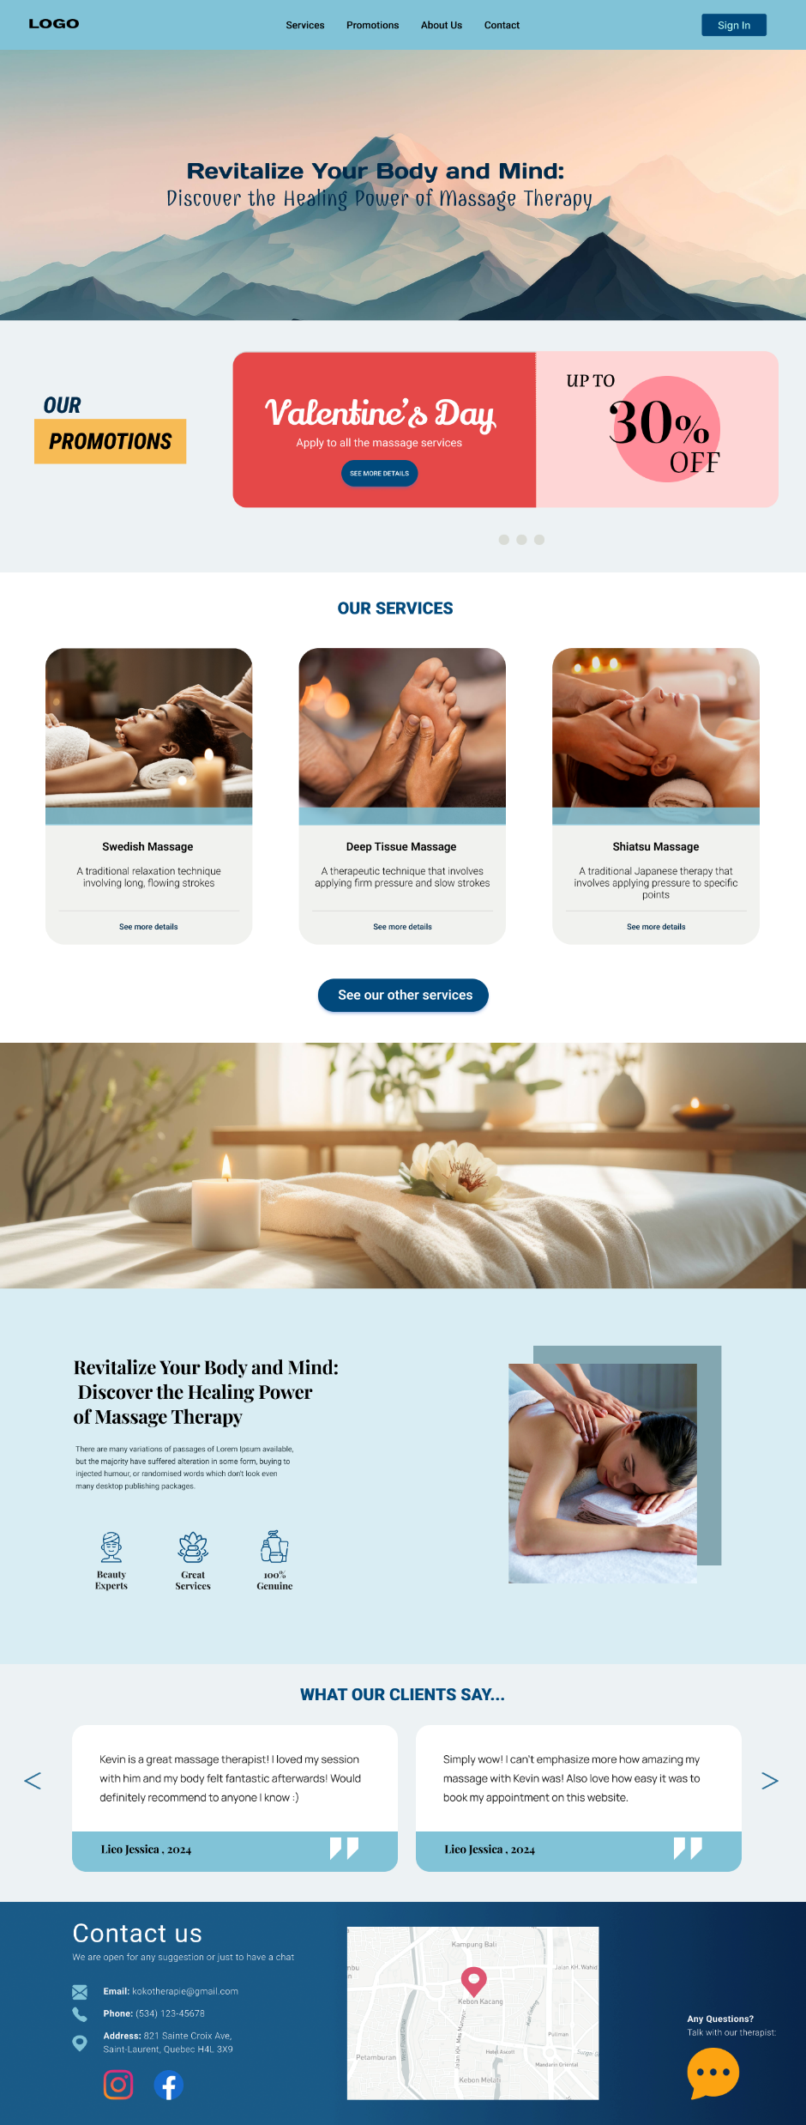

MAIN PAGE
Links to other pages
Login / Registration
Link to promotions

Slide 4
Links to services page

Slide 5
Feedback (scrolls)
Google Maps API

Slide 6

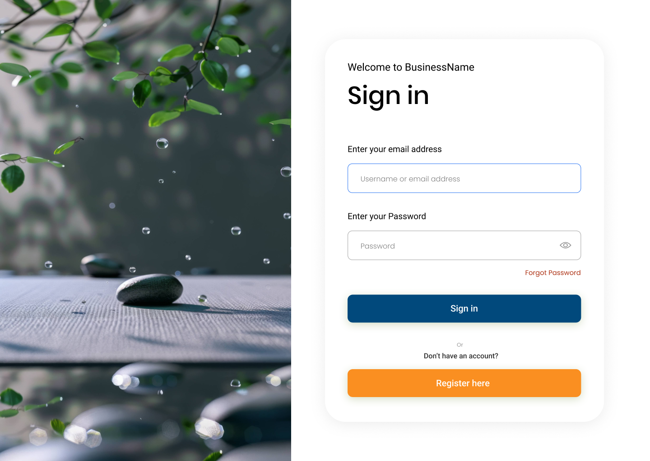
Password verification
Link to Registration Page

Slide 7
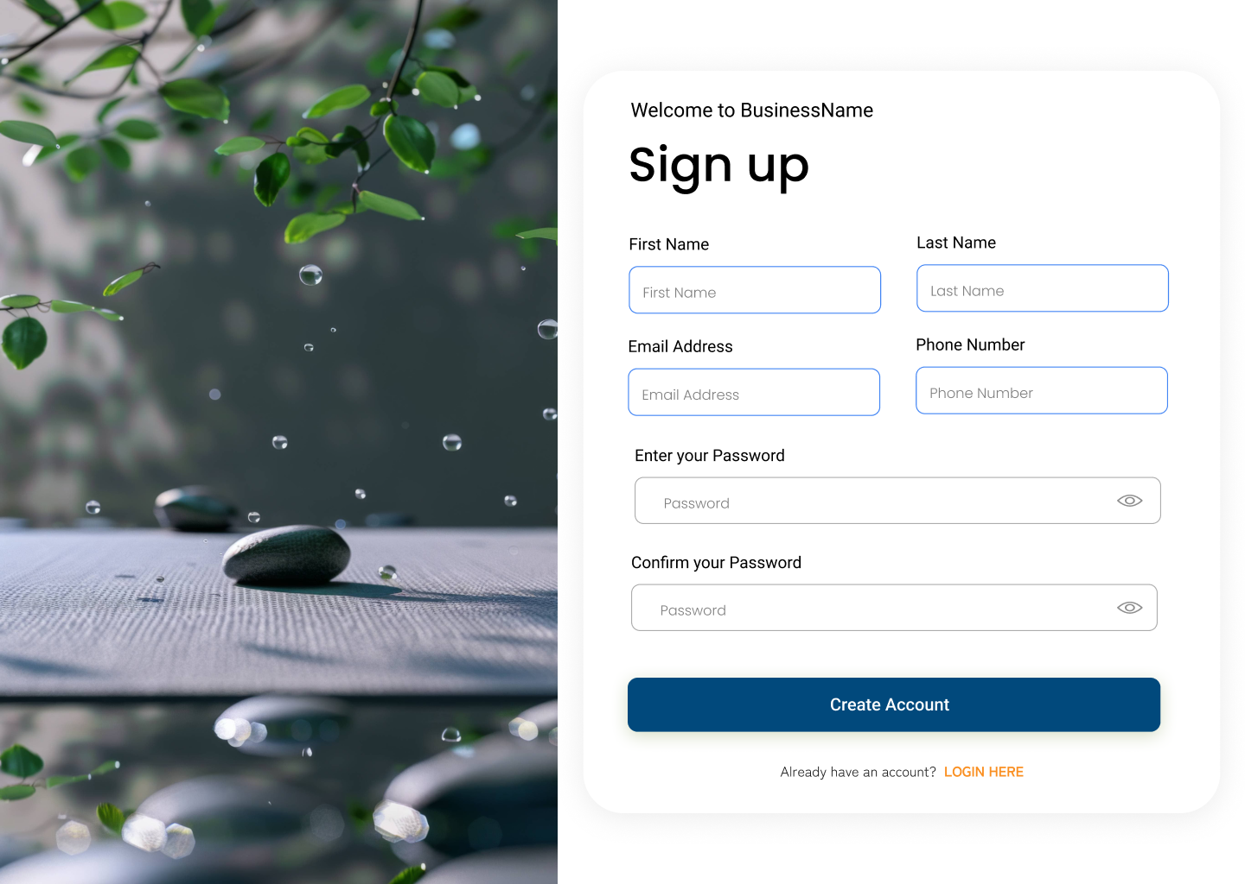

Create an Account confirmation Message
Link to Login Page

Slide 8

ABOUT US

Slide 9
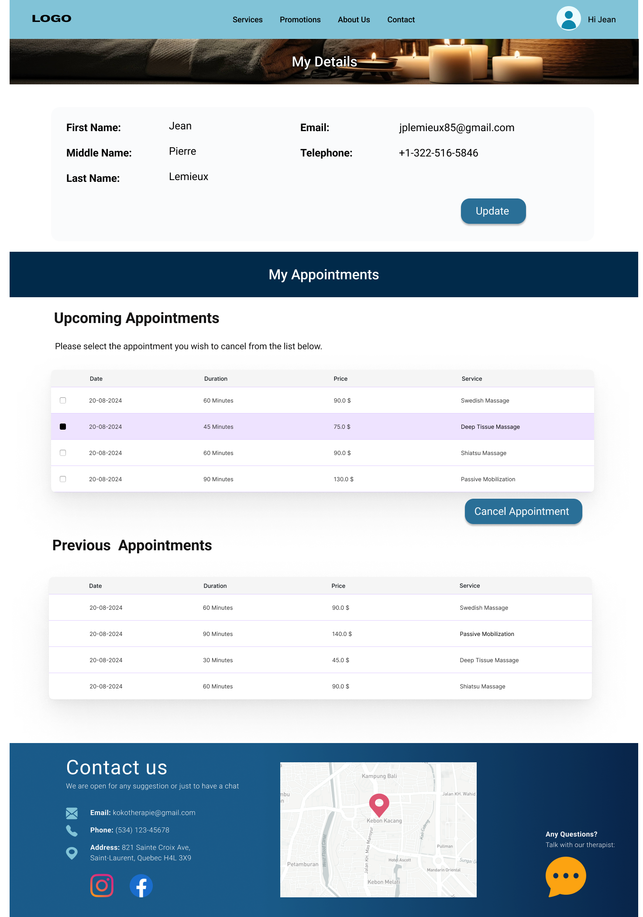
MY PROFILE
Update profile details
Highlights selection
Confirm cancellation

Slide 10
View of previous appointments

Slide 11
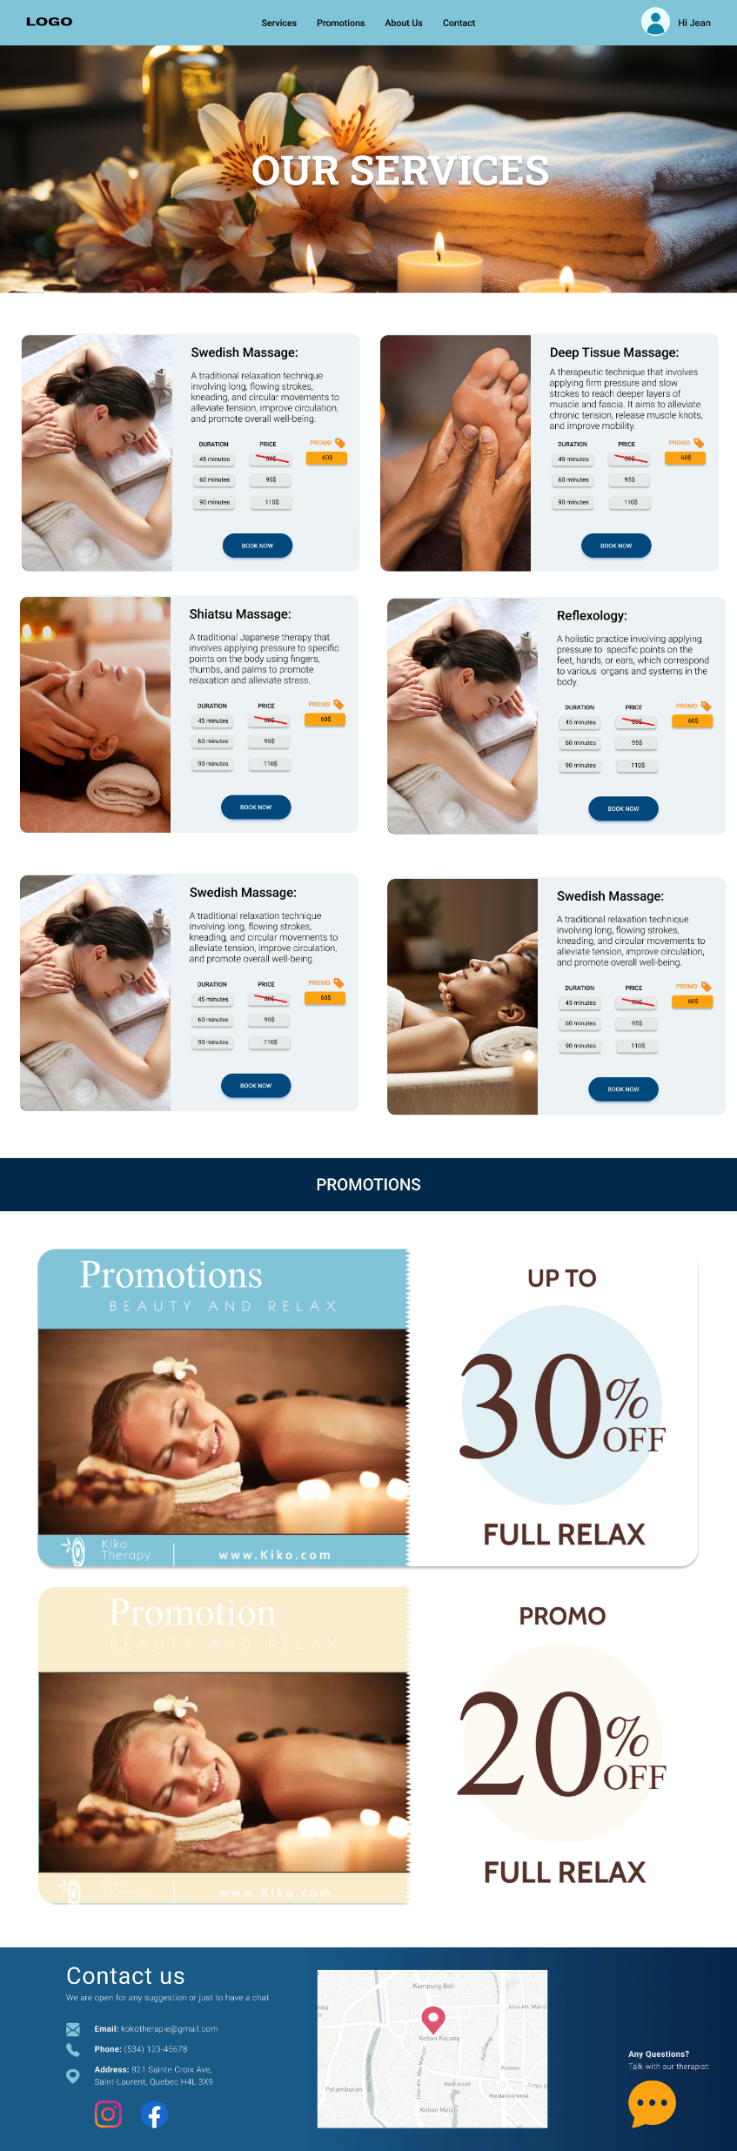
SERVICES
Competitive Advantage 1:
Our staff undergo rigorous training to make sure their skills are topnotch
Promo Price
Link to the Book Appointment Page

Slide 12
Competitive Advantage 1:
Our staff undergo rigorous training to make sure their skills are topnotch
Promotions Page

Slide 13
Competitive Advantage 1:
Our staff undergo rigorous training to make sure their skills are topnotch

Slide 14
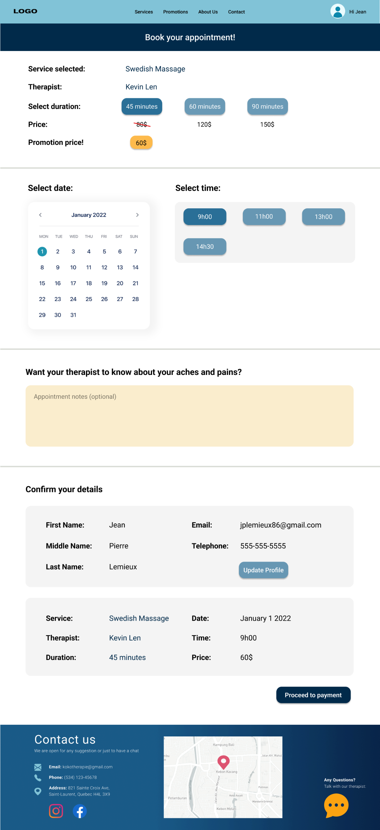
BOOKING
Select duration/price
Select date/time

Slide 15
Leave note
Confirm profile/details
Link to payment

Slide 16
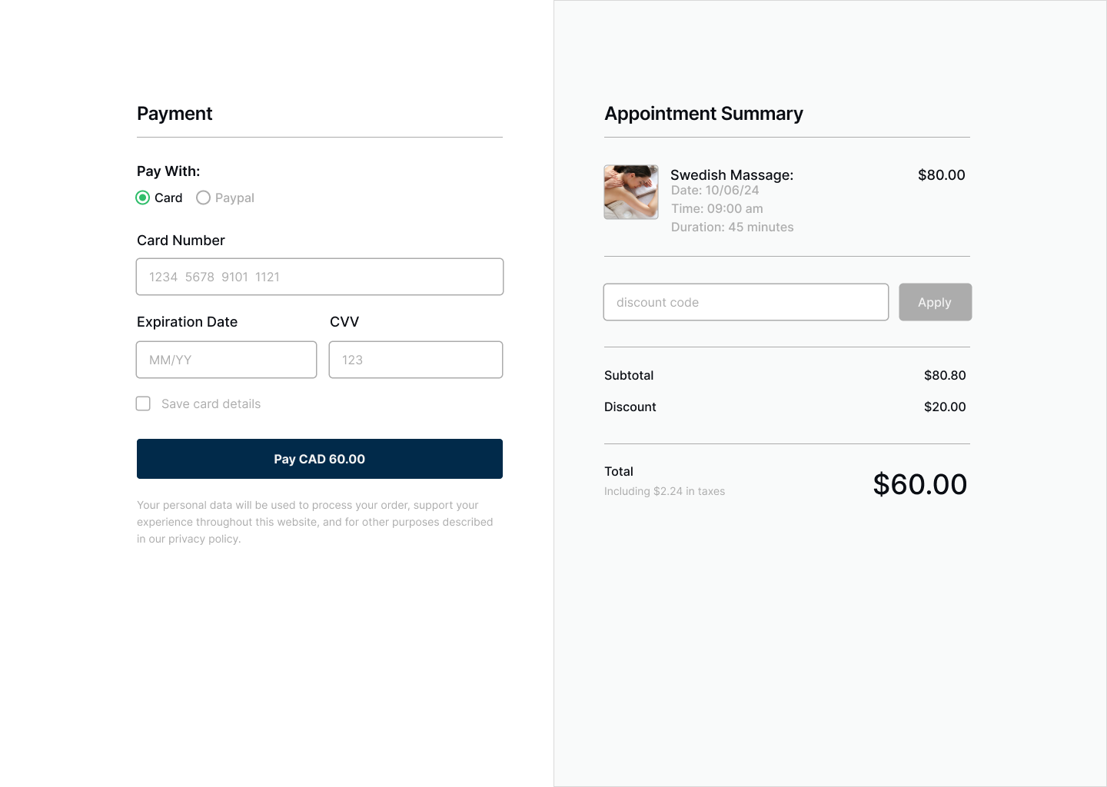
2 types of payments
PAYMENT
Discount codes available will be shown as selection for the user
Payment confirmation

Slide 17
Other information
Programming language: React.js
Server language: Node.js
Database: MongoDB
GitHub link:

Slide 18





Thank you!

